Slide 1
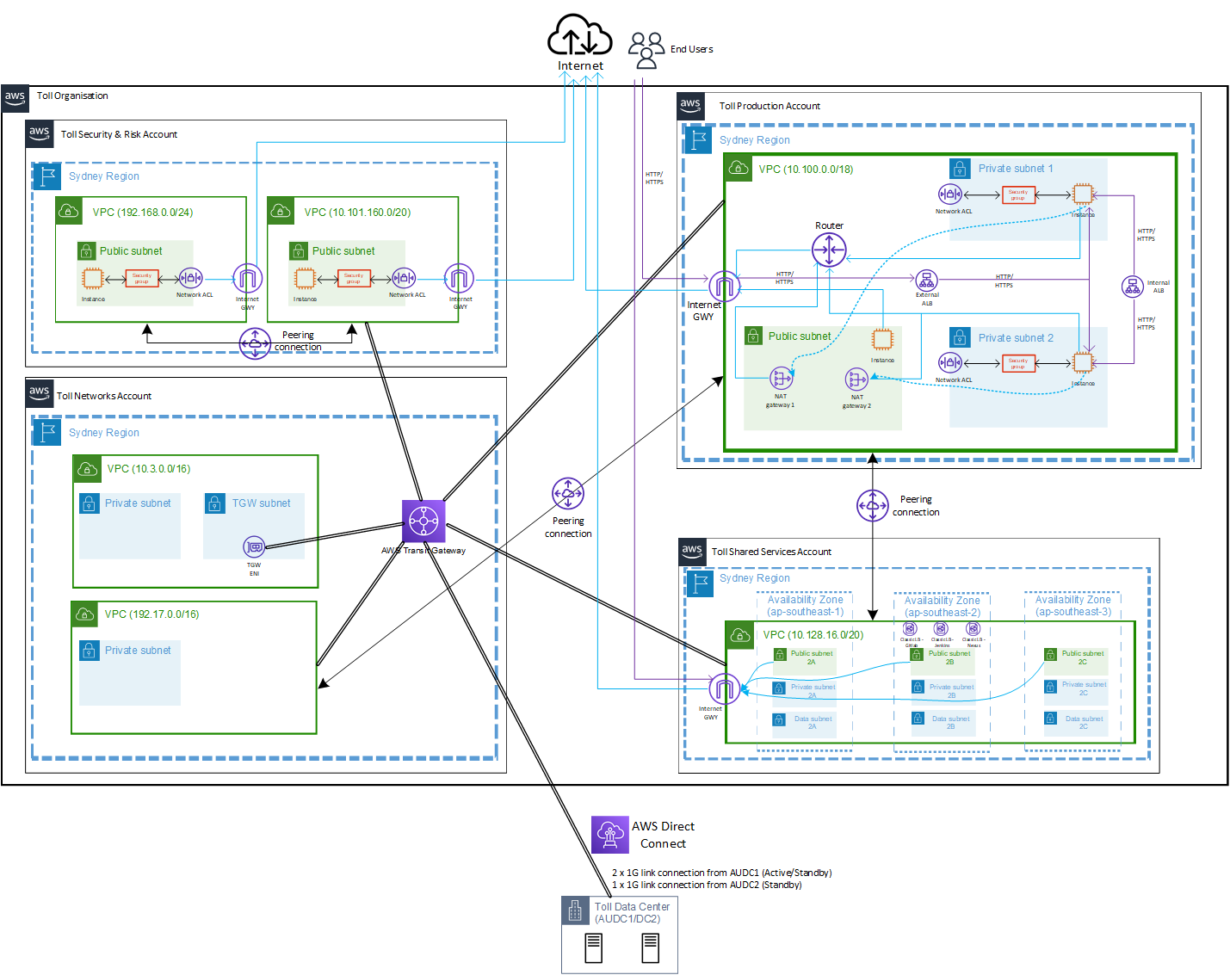
Architecture framework: Current AWS architecture
Sydney and China regions with multi-AZ (three zones).
Security groups (first defense layer) and Network ACLs (second defense layer) are used as ‘virtual firewall’ for network protection of AWS services.
AWS Transit Gateway (TGW) have been deployed in August 2020, but not fully attached and configured on all VPCs – 33/52 TGWs (~63%).
VPC Peering connections still in use in the environment – 28 active peering connections.
ELB (ALB, NLB and Classic LB) and CloudFront are used, but with limited to no AWS Shield Advanced and WAF protection.
Toll has already paid AWS Shield Advanced monthly subscription (US$3000) but did not deploy the solution to all Internet-facing web sites.
NOTE: This is a subset view of AWS environment for demonstration purposes only.
Outbound traffic
Inbound traffic

Slide 2
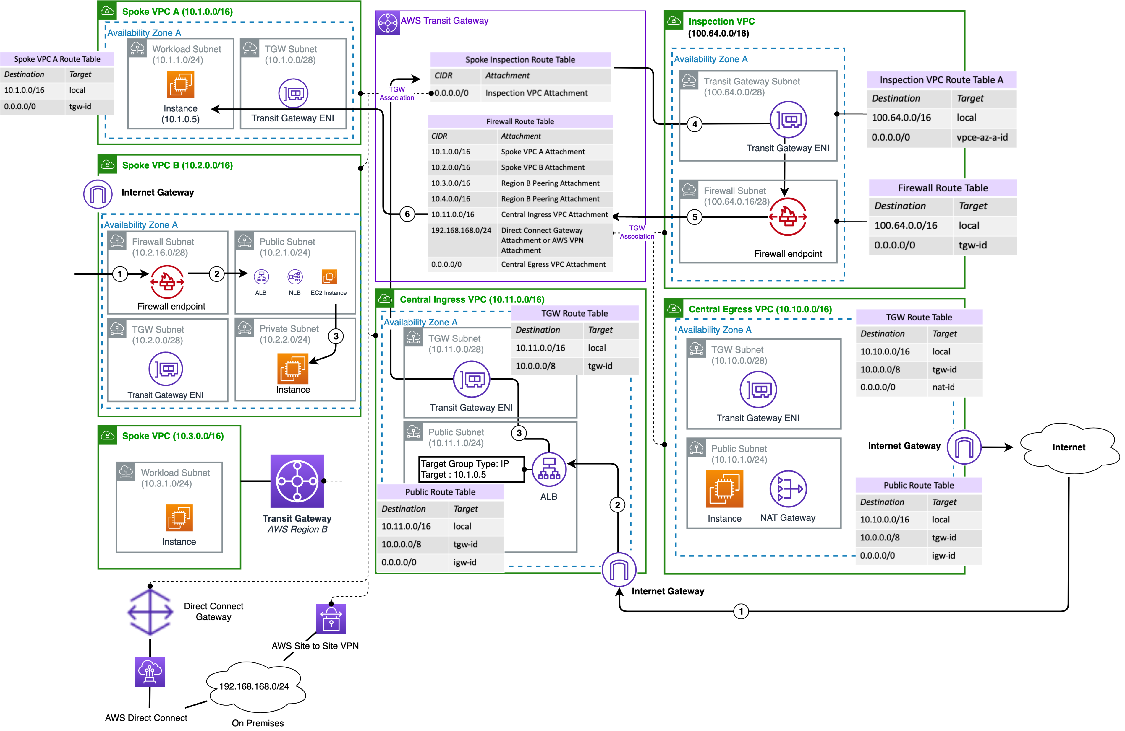
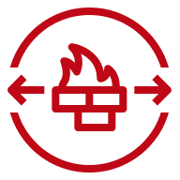
Options considered: Combined (Distributed+Centralized) AWS Network Firewall
For combined centralized and distributed deployment model, we can deploy AWS Network Firewall in the central inspection VPC and also in each VPC which requires local internet ingress and/or egress – existing VPC workloads.
In this model, workloads can use local IGW and connect to internal networks (VPCs, on-premises) through the centralized inspection VPC.
Private subnets in such VPC retain an option to use centralized internet egress VPC.
Firewall endpoint
Spoke VPC B with local IGW protected by dedicated AWS Network Firewall

Slide 3
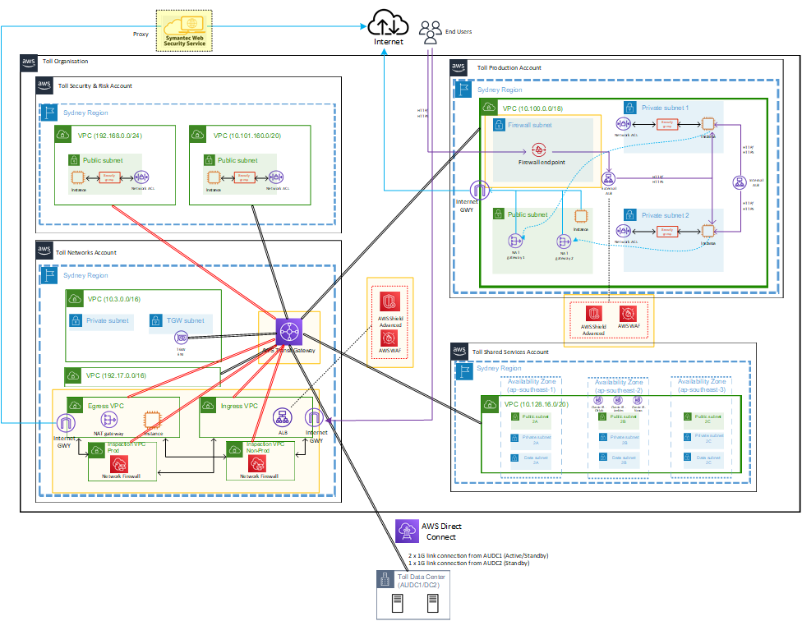
Architecture framework: Target AWS architecture
Introduction of the new ‘Inspection VPC Prod’, ‘Inspection VPC Non-Prod’, ‘Egress VPC’ and ‘Ingress VPC’ in Toll Networks Account for Centralized Internet Firewall Deployment.
Separate ‘Non-Prod Inspection VPC’ for testing of Firewall rules/policies prior to Production deployment.
AWS Network Firewall complements existing network and application security services on AWS by providing control and visibility to Layer 3-7 network traffic for the entire VPC allowing in depth defense, intrusion detection and prevention service.
Add/enable AWS Shield Advanced and WAF to ELB, CloudFront and EC2 to complement the existing security groups and network ACLs for protection against DDoS, SQL & XSS injection, HTTP flood, IP reputation lists, bad bot etc.
Dedicated Network Firewall (firewall endpoint) to be added to the ‘existing VPC’ (ie. Distributed Firewall model) - only by exemption, where we cannot migrate the existing workloads due to its complexity, business impact or technical limitation moving to the Centralized model.
Transit Gateway route tables to be updated.
NOTE: This is a subset view of AWS environment for demonstration purposes only.
* Web proxy is added for future enhancement.
Outbound traffic
Inbound traffic
Centralized Internet Firewall Deployment

Slide 4
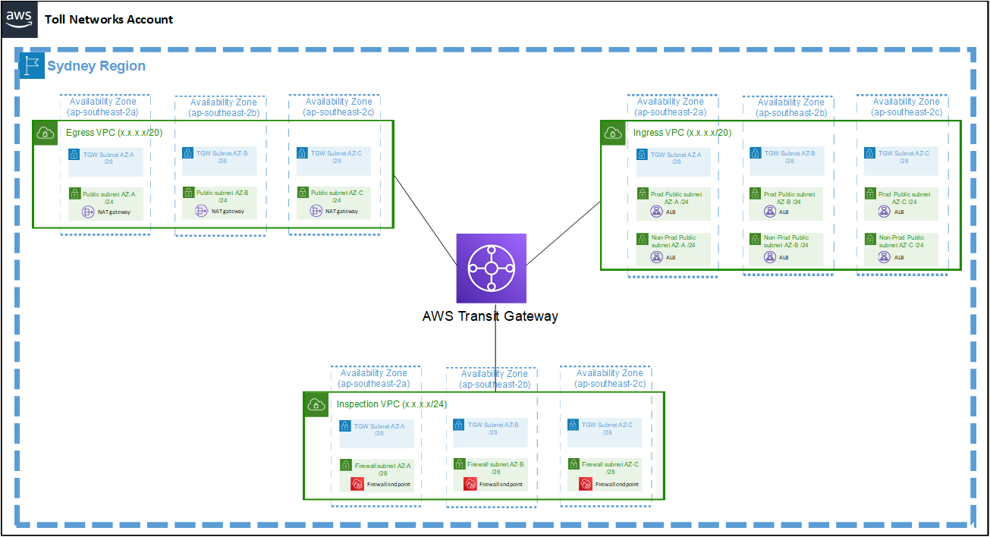
Architecture framework: Target AWS architecture
‘Ingress VPC’, ‘Egress VPC’ and ‘Inspection VPC’ model - not recommended

Slide 5
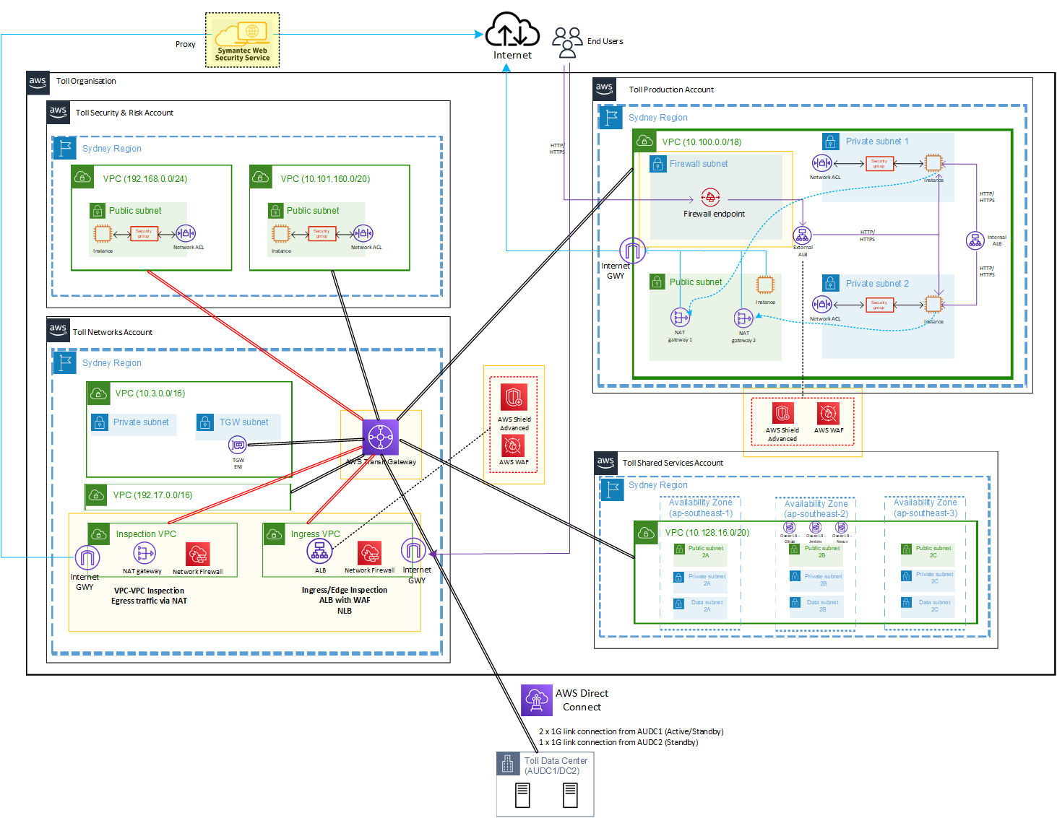
Architecture framework: Target AWS architecture ***UPDATED
Introduction of the new ‘Ingress VPC’ and ‘Inspection VPC’, in Toll Network Account for Centralized Internet Firewall Deployment.
Separate Prod and Non-Prod firewall traffic using Firewall Rule Group.
AWS Network Firewall complements existing network and application security services on AWS by providing control and visibility to Layer 3-7 network traffic for the entire VPC allowing in depth defense, intrusion detection and prevention service.
Add/enable AWS Shield Advanced and WAF to ELB, CloudFront and EC2 to complement the existing security groups and network ACLs for protection against DDoS, SQL & XSS injection, HTTP flood, IP reputation lists, bad bot etc.
Dedicated Network Firewall (firewall endpoint) to be added to the ‘existing VPC’ (ie. Distributed Firewall model) - only by exemption, where we cannot migrate the existing workloads due to its complexity, business impact or technical limitation moving to the Centralized model.
Transit Gateway route tables to be updated.
NOTE: This is a subset view of AWS environment for demonstration purposes only.
* Web proxy is added for future enhancement.
Outbound traffic
Inbound traffic
Centralized Internet Firewall Deployment

Slide 6
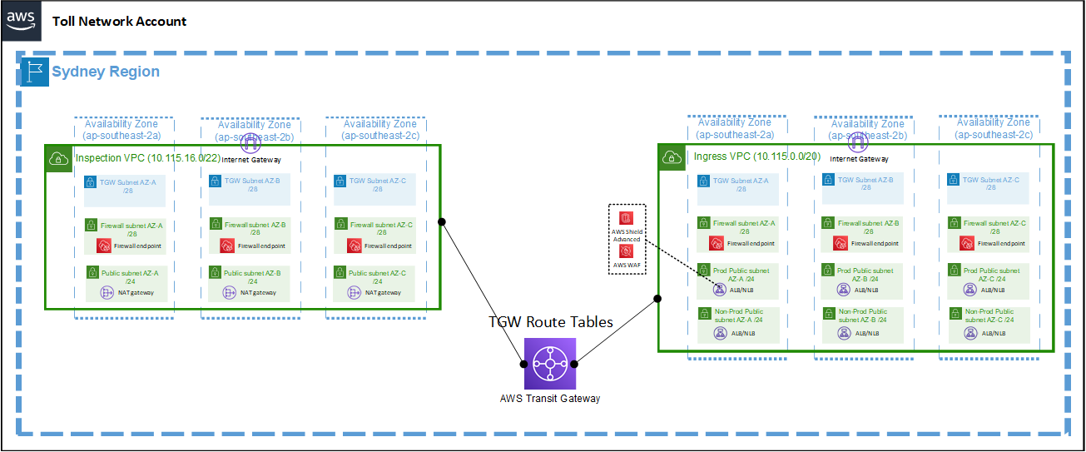
Architecture framework: ‘UPDATED’ Target AWS architecture
Central ‘Ingress VPC’ and ‘Inspection VPC’ model - RECOMMENDED
Elastic IP
Elastic IP
Elastic IP

Slide 7
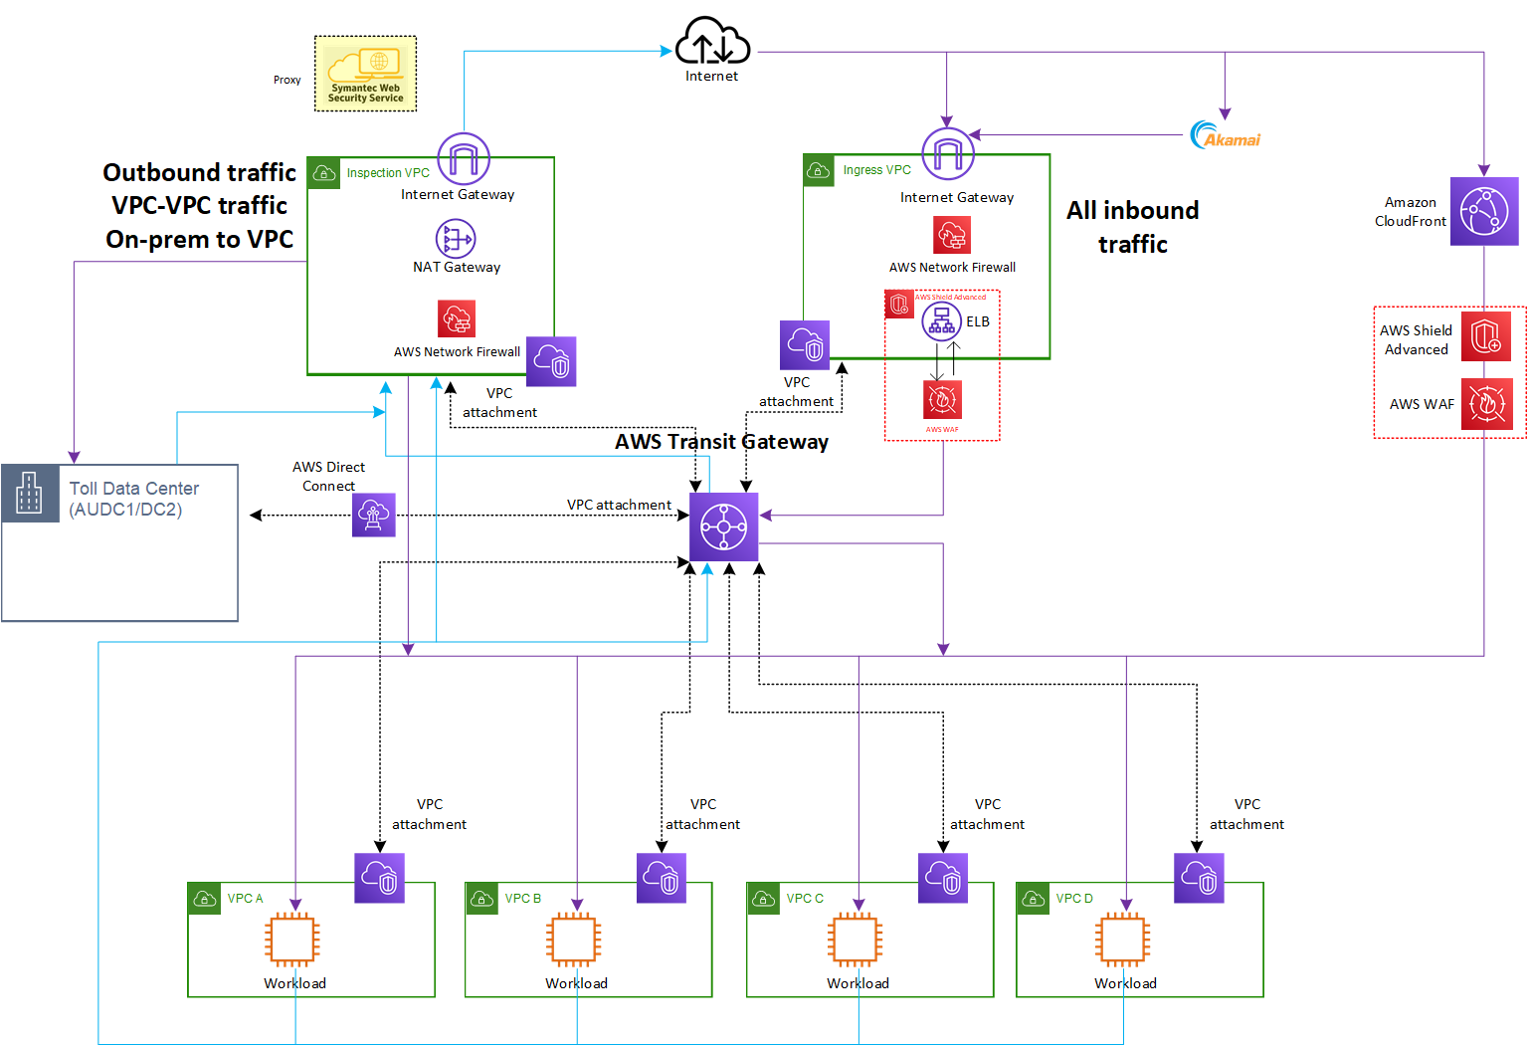
Architecture framework: ‘UPDATED’ Logical view (centralized)
Outbound traffic
Inbound traffic
* Refer to Appendix C – E for more detailed traffic flow.

Slide 8
Test Cases
Passed Test Cases
Allow specific Public IP to ALB via Fw
Allow specific Public IP to ALB via WAF
Allow specific Public IP to NLB
Block specific Public IP to ALB via Fw
Block specific Public IP to ALB via WAF
Block specific Public IP to NLB
Allow inter VPC (VPC <-> VPC) connectivity
Block inter VPC (VPC <-> VPC) connectivity
Static Public IP for ALB - ALB behind NLB (ie NLB -> ALB)
- Allow specific IP
- Block specific IP
Allow EC2 access to Internet specific website/domain, eg: google.com
Block EC2 from Internet access to specific website/domain, eg: youtube.com

Slide 9
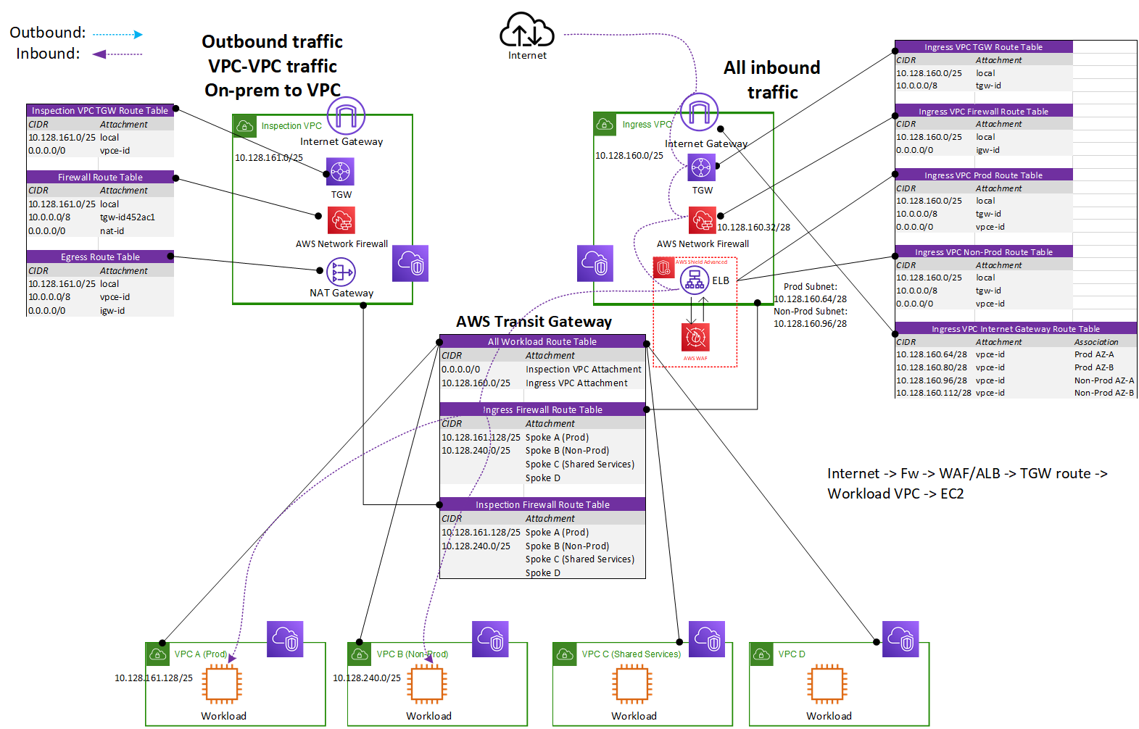
Demo: Traffic flow ingress
1
2
3
4
5
6
6

Slide 10
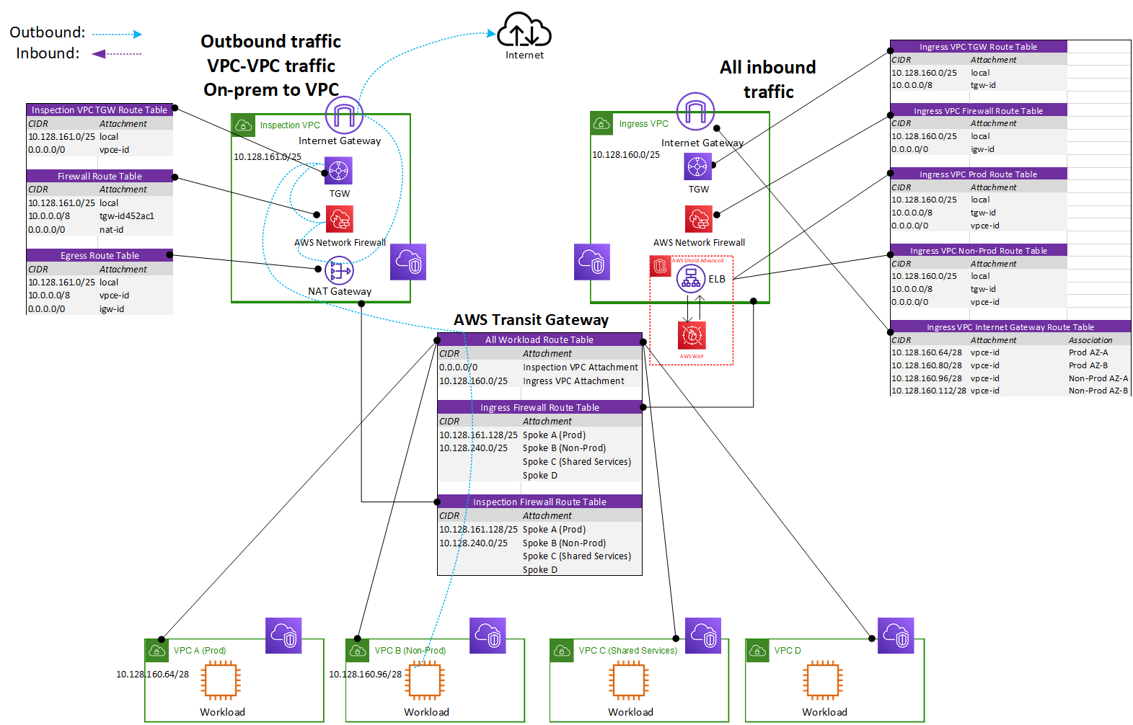
Demo: Traffic flow egress
6
3
5
4
2
1

Slide 11
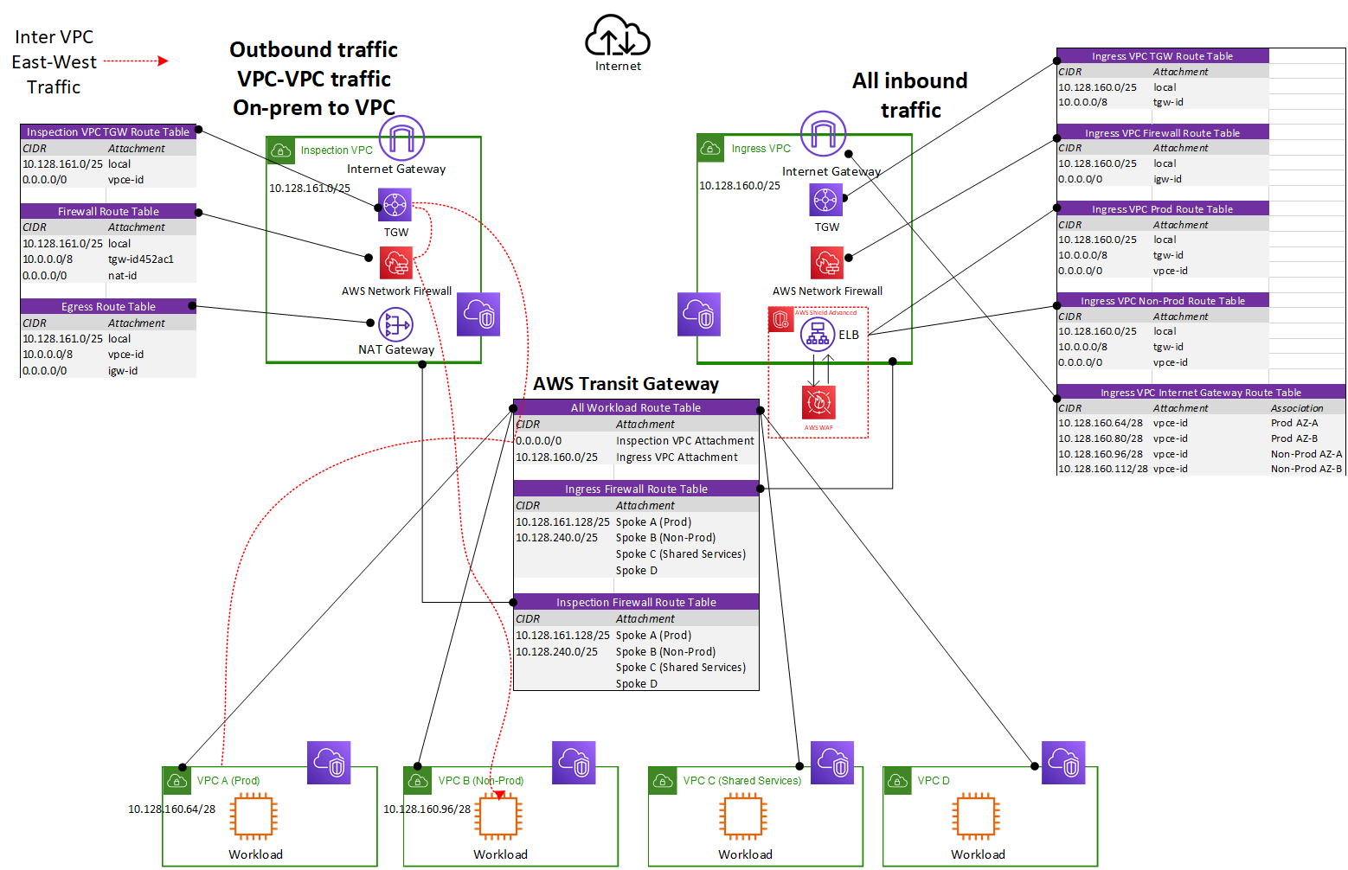
Demo: Traffic flow inter-VPC
3
2
4
1

Slide 12
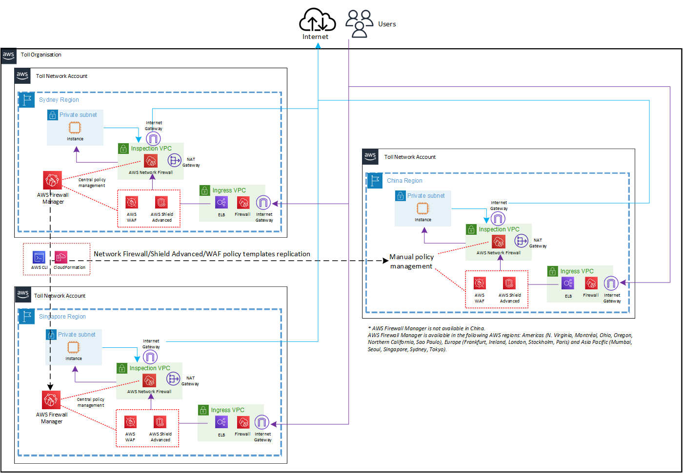
AWS network firewall topology for scalability
“Inter-region Transit Gateway peering” service between Sydney and China region is not available.
AWS Firewall Manager, for central management of Firewall policies, is not available in China.
Inter-region Transit Gateway peering is available in US East (N. Virginia), US East (Ohio), US West (Oregon), EU (Ireland), and EU (Frankfurt) AWS Regions.
As per AWS recommendation, separate network management between regions is preferred to avoid cross-region traffic inspection (high latency and cost).
Firewall policy cannot be ‘shared’ cross-regions, however, CloudFormation and AWS CLI can be used for export/import of the policies between the source region (Sydney) and the target region (China, Singapore, US, UK etc).

Slide 13
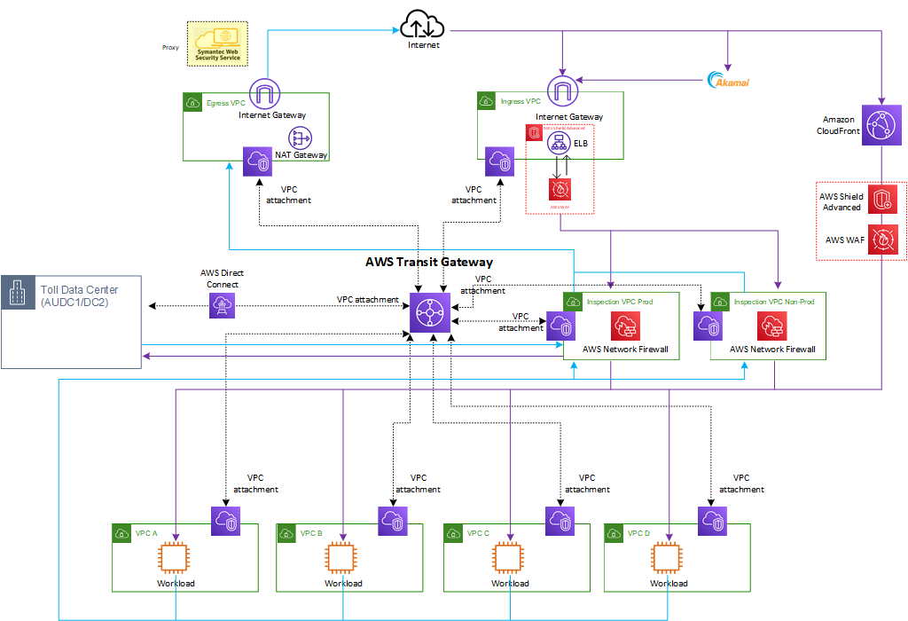
Architecture framework: Logical view (centralized)
Outbound traffic
Inbound traffic
* Refer to Appendix C – F for more detailed traffic flow.

Slide 14
Architecture framework: Logging and monitoring
AWS provides a number of tools that you can use to monitor Network Firewall, Shield Advanced and WAF.
Amazon CloudWatch provides metrics for the AWS resources and services. Monitoring and alarms are real time.
Amazon CloudWatch Logs provides logging for sources such as Amazon EC2 instances and CloudTrail. CloudWatch Logs can monitor information in the log files and notify you when certain thresholds are met.
Amazon CloudWatch Events automatically respond to system events for your AWS services. Events from AWS services are delivered to CloudWatch Events in near real time, and you can specify automated actions to take when an event matches a rule that you write.
AWS CloudTrail captures API calls and related events made by or on behalf of your AWS account and delivers the log files to an Amazon S3 bucket that you specify. You can identify which users and accounts called AWS, the source IP address from which the calls were made, and when the calls occurred.
Logging destinations
S3 buckets
CloudWatch Logs
Toll SOC – CyberCX Splunk SIEM

Slide 15
Decommissioning opportunities
Potential decommissioning of
existing Network ACLs as this will be replaced by AWS Network Firewall
existing Internet gateway in the non-ingress VPC
existing NAT gateway and NAT instance
VPC peering connections

Slide 16
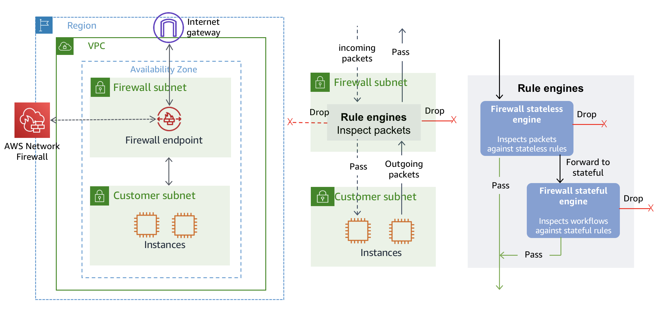
Appendix B: Network Firewall concepts
Firewall – A firewall connects the VPC that you want to protect to the protection behavior that’s defined in a firewall policy. For each Availability Zone where you want protection, you provide Network Firewall with a public subnet that’s dedicated to the firewall endpoint. To use the firewall, you update the VPC route tables to send incoming and outgoing traffic through the firewall endpoints.
Firewall policy – A firewall policy defines the behavior of the firewall in a collection of stateless and stateful rule groups and other settings. You can associate each firewall with only one firewall policy, but you can use a firewall policy for more than one firewall.
Rule group – A rule group is a collection of stateless or stateful rules that define how to inspect and handle network traffic. Rules configuration includes 5-tuple and domain name filtering. You can also provide stateful rules using a Suricata open source rule specification.

Slide 17
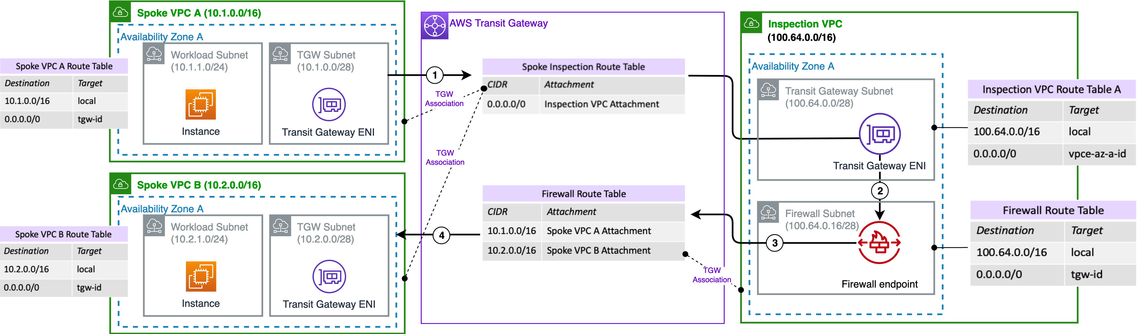
Appendix C: Inspection VPC (Inter-VPC)
East-West Traffic Inspection (Inter-VPC)

Slide 18
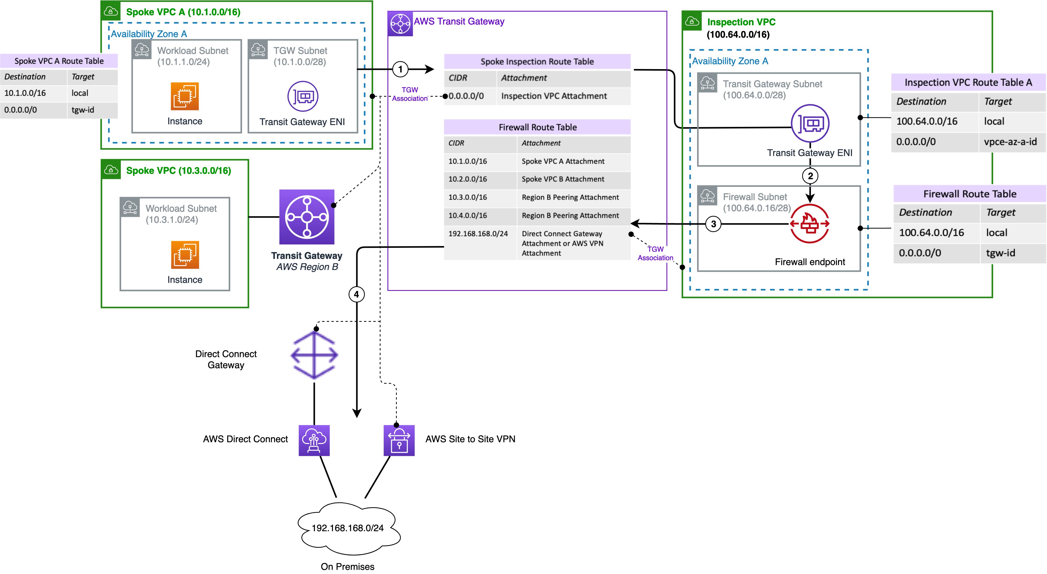
Appendix D: Inspection VPC (VPC & on-premise)
North-South Traffic Inspection (on-premise egress & ingress via Transit Gateway and Direct Connect Gateway)

Slide 19
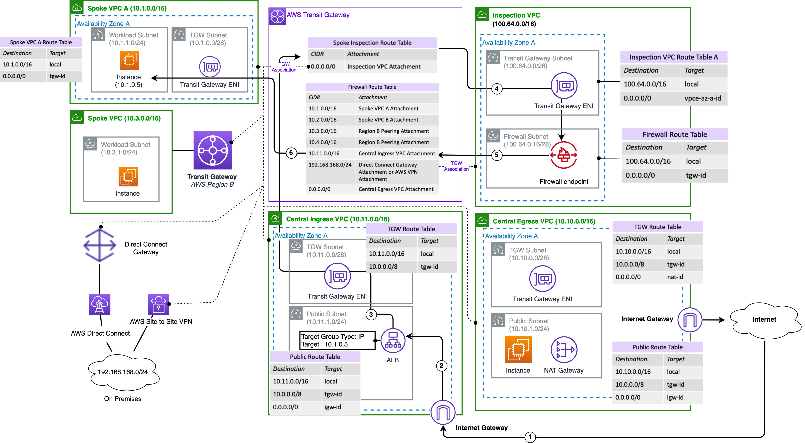
Appendix E: Ingress VPC

Slide 20
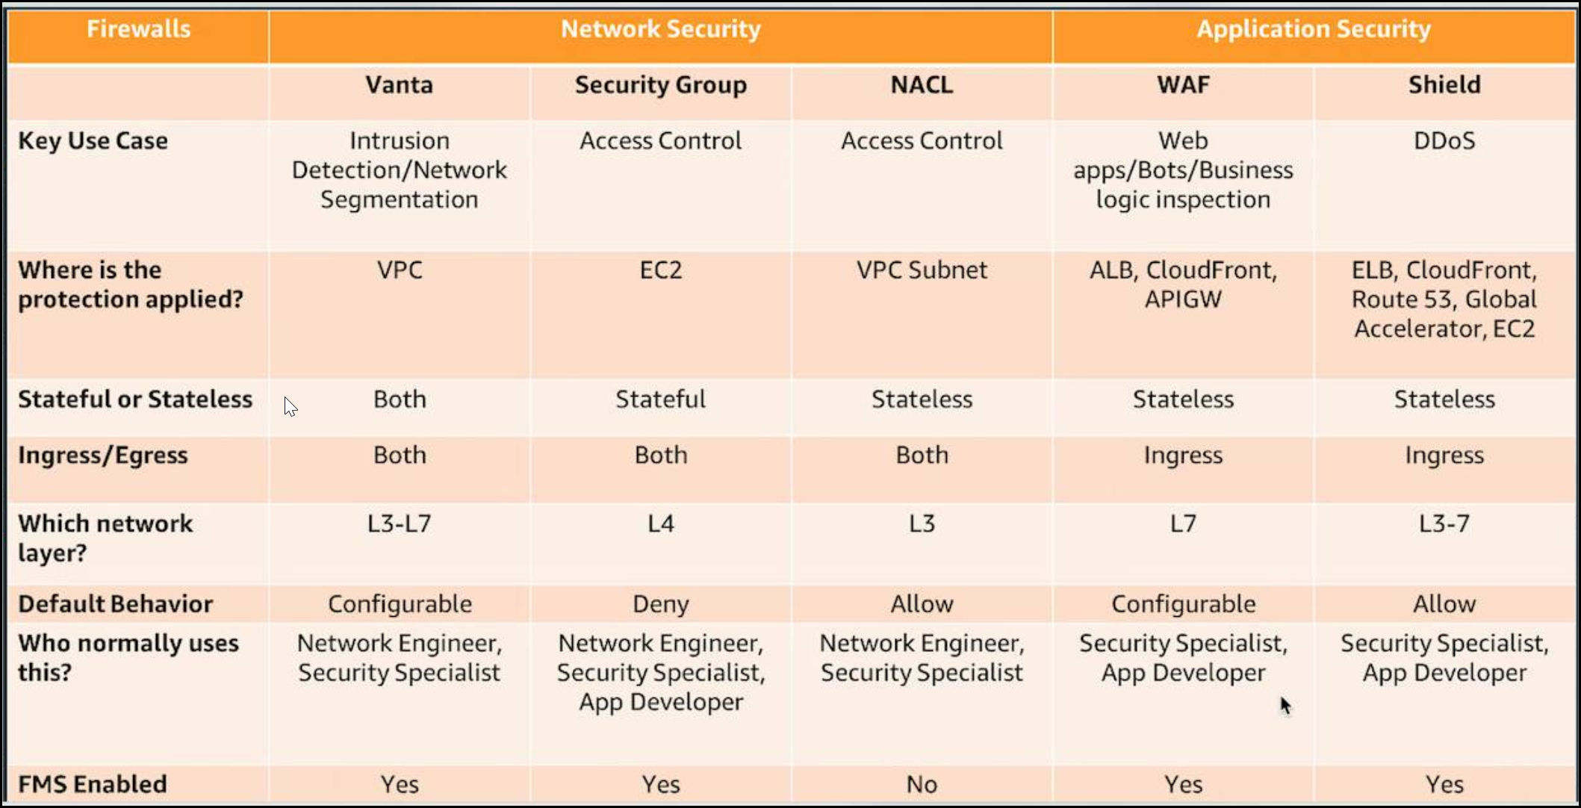
Appendix F: AWS Security Scope
Network Firewall

Slide 21
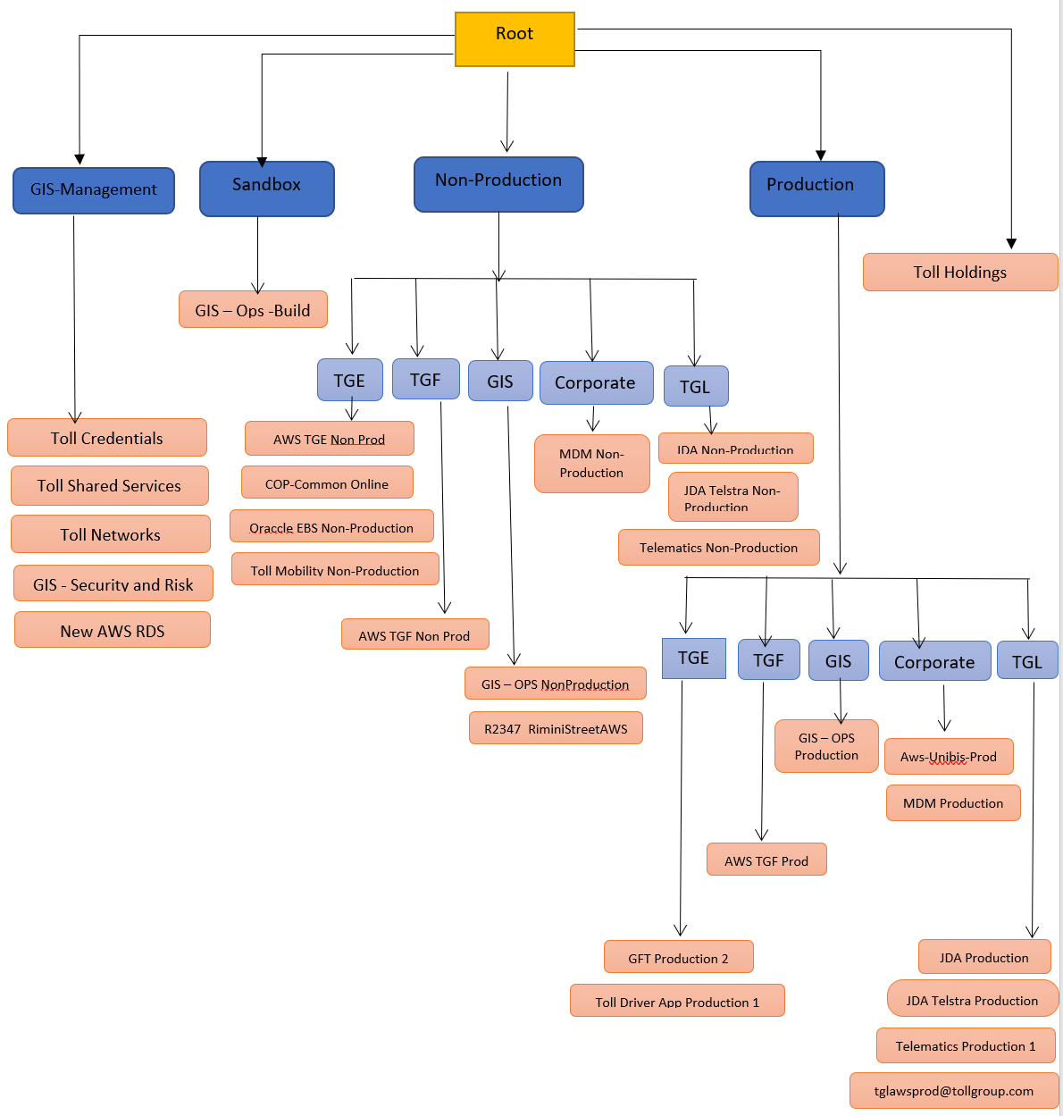
Appendix H: Current AWS Organization Structure
Management Account (Master)
OU (Organization Unit)
Account
Nested OU (Organization Unit)
Account
Note: this organization structure will be changed with the introduction of AWS Control Tower (part of AWS Cyber Remediation) for streamlined management and governance of multi-account AWS environment, called a landing zone.

Slide 22
